Slide 1

Introduction to Text Categorization
Lecturer: Paul Bennett
20-760: Web-Based Information Architectures
July 23, 2002
Notes:
“Text Classification” and “Text Categorization” are used interchangeably.

Slide 2

Lecture Overview
Motivation for Automatic Text Categorization
A Text Categorization Example
Approaches to Automatic Text Categorization (emphasizing the “k-Nearest Neighbor approach”)
Evaluation Methodology and Performance Metrics
Summary

Slide 3
Motivation for Automatic Text Categorization

Slide 4

Shopping on the Web
Suppose you want to buy a cappuccino maker as a gift
  try Google for “cappuccino maker”
  try “Yahoo! Shopping” for “cappuccino maker”

Slide 5
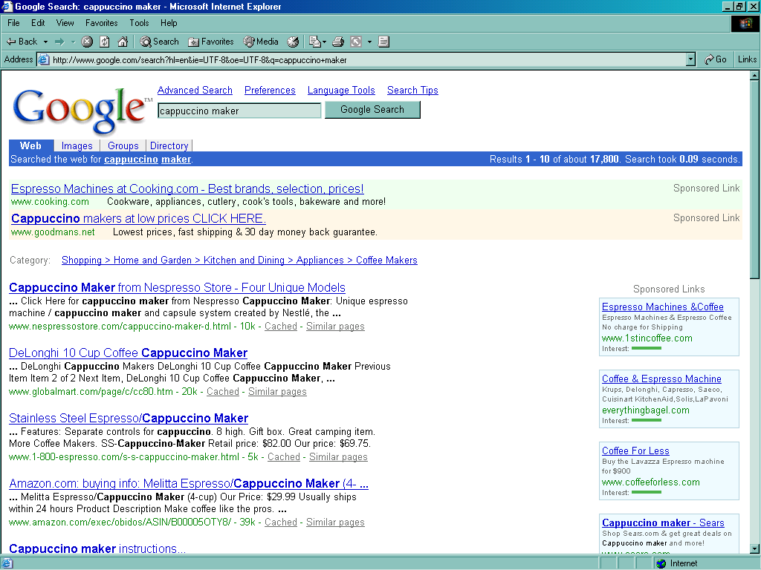
Notes:
You can get to a Google hierarchy indirectly if you note the
“Shopping > Home and Garden ...” link.

Slide 6
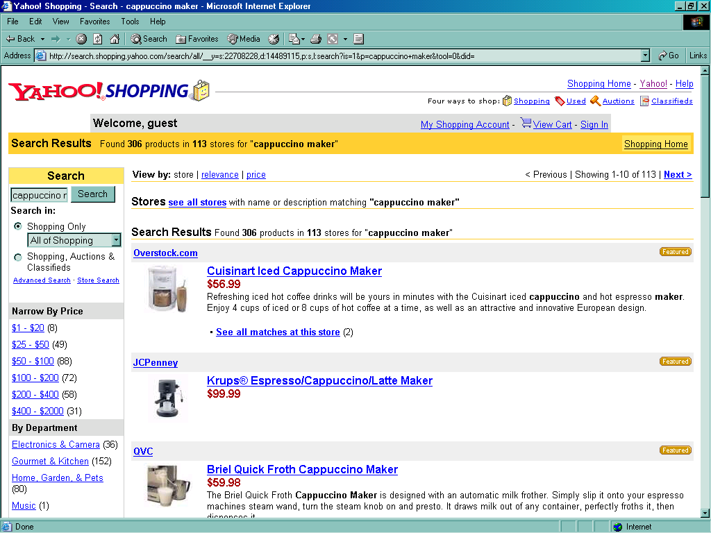

Slide 7
Observations
Broad indexing & speedy search alone are not enough.
Organizational view of data is critical for effective retrieval.
Categorized data are easy for user to browse.
Category taxonomies become most central in well-known web sites (Yahoo!, Lycos, ...).

Slide 8
Text Categorization Applications
Web pages organized into category hierarchies
Journal articles indexed by subject categories (e.g., the Library of Congress, MEDLINE, etc.)
Responses to Census Bureau occupations
Patents archived using International Patent Classification
Patient records coded using international insurance categories
E-mail message filtering
News events tracked and filtered by topics

Slide 9
Cost of Manual Text Categorization
  Yahoo!
      200 (?) people for manual labeling of Web pages
      using a hierarchy of 500,000 categories
  MEDLINE (National Library of Medicine)
      $2 million/year for manual indexing of journal articles
      using MEdical Subject Headings (18,000 categories)
  Mayo Clinic
      $1.4 million annually for coding patient-record events
      using the International Classification of Diseases (ICD) for billing insurance companies
  US Census Bureau decennial census (1990: 22 million responses)
      232 industry categories and 504 occupation categories
      $15 million if fully done by hand
Notes:
Why not simply categorize by hand? Too time and resource intensive.

Slide 10
What does it take to compete?
Suppose you were starting a web search company, what would it take to compete with established engines?
  You need to be able to establish a competing hierarchy fast.
  You will need a relatively cheap solution. (Unless you have investors that want to pay millions of dollars just to get off the ground.)

Slide 11
Why not a semi-automatic text categorization tool?
Humans can encode knowledge of what constitutes membership in a category.
This encoding can then be automatically applied by a machine to categorize new examples.
For example...

Slide 12
Rule-based Approach to TC
Text in a Web Page
“Saeco revolutionized espresso brewing a decade ago by introducing Saeco SuperAutomatic machines, which go from bean to coffee at the touch of a button. The all-new Saeco Vienna Super-Automatic home coffee and cappucino machine combines top quality with low price!”
Rules
  Rule 1.
  (espresso or coffee or cappucino ) and machine* Coffee Maker
  Rule 2.
  automat* and answering and machine* Phone
  Rule ...

Slide 13
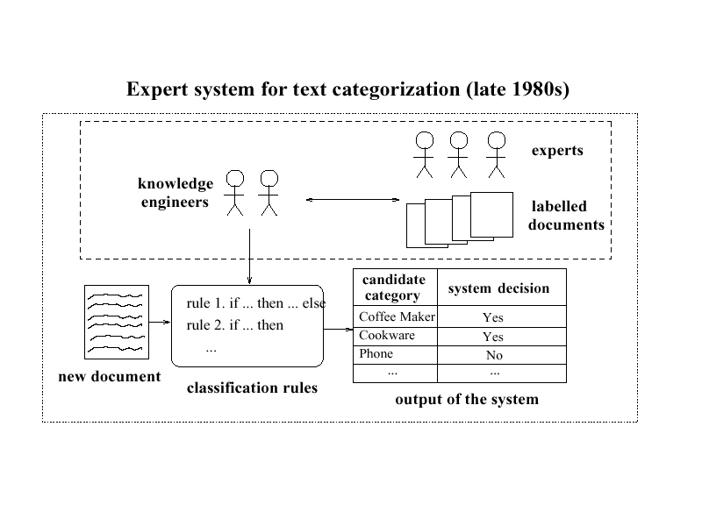
Expert System for TC (late 1980s)

Slide 14
Defining Rules By Hand
Experience has shown
  too time consuming
  too difficult
  inconsistency issues (as the rule set gets large)

Slide 15
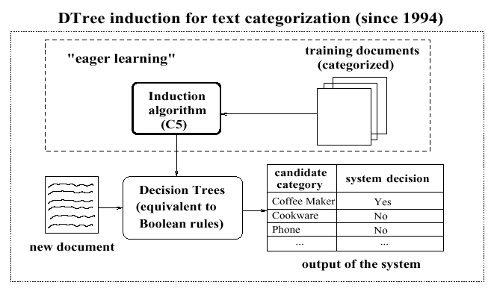
Replace Knowledge Engineering with a Statistical Learner
Notes:
A decision tree learner is a statistical learner that learns rules based on statistical patterns in the data.

Slide 16
Knowledge Statistical
Engineering Learning
vs.
For US Census Bureau Decennial Census 1990
  232 industry categories and 504 occupation categories
  $15 million if fully done by hand
Define classification rules manually:
  Expert System AIOCS
  Development time: 192 person-months (2 people, 8 years)
  Accuracy = 47%
Learn classification function
  Nearest Neighbor classification (Creecy ’92: 1-NN)
  Development time: 4 person-months (Thinking Machine)
  Accuracy = 60%

Slide 17
A Text Categorization Example

Slide 18
Predicting Topics of News Stories
Given: Collection of example news stories already labeled with a category (topic).
Task: Predict category for news stories not yet labeled.
For our example, we’ll only get to see the headline of the news story.
We’ll represent categories using colors. (All examples with the same color belong to the same category.)

Slide 19
Our Labeled Examples
Amatil Proposes Two-for-Five Bonus Share Issue
Citibank Norway Unit Loses Six Mln Crowns in 1986
Japan Ministry Says Open Farm Trade Would Hit U.S.
Vieille Montagne Says 1986 Conditions Unfavourable
Jardine Matheson Said It Sets Two-for-Five Bonus Issue Replacing “B” Shares
Anheuser-Busch Joins Bid for San Miguel
Italy’s La Fondiaria to Report Higher 1986 Profits
Isuzu Plans No Interim Dividend
Senator Defends U.S. Mandatory Farm Control Bill
Bowater Industries Profit Exceed Expectations

Slide 20
What to predict before seeing the document?
?
Amatil Proposes Two-for-Five Bonus Share Issue
Citibank Norway Unit Loses Six Mln Crowns in 1986
Japan Ministry Says Open Farm Trade Would Hit U.S.
Vieille Montagne Says 1986 Conditions Unfavourable
Jardine Matheson Said It Sets Two-for-Five Bonus Issue Replacing “B” Shares
Anheuser-Busch Joins Bid for San Miguel
Italy’s La Fondiaria to Report Higher 1986 Profits
Isuzu Plans No Interim Dividend
Senator Defends U.S. Mandatory Farm Control Bill
Bowater Industries Profit Exceed Expectations
Notes:
If we have no other information, our best guess is probably the gray-green category (since it is the most common).

Slide 21
Predict with Evidence
Senate Panel Studies Loan Rate, Set Aside Plans
Amatil Proposes Two-for-Five Bonus Share Issue
Citibank Norway Unit Loses Six Mln Crowns in 1986
Japan Ministry Says Open Farm Trade Would Hit U.S.
Vieille Montagne Says 1986 Conditions Unfavourable
Jardine Matheson Said It Sets Two-for-Five Bonus Issue Replacing “B” Shares
Anheuser-Busch Joins Bid for San Miguel
Italy’s La Fondiaria to Report Higher 1986 Profits
Isuzu Plans No Interim Dividend
Senator Defends U.S. Mandatory Farm Control Bill
Bowater Industries Profit Exceed Expectations
Notes:
Why do we think this belongs to the yellow-orange category?
“Senate” and “Senator” seem related.
All discuss government related issues as well. If we have a “related word list” (a.k.a. query expansion) we might find the related words have a high overlap.
(All actually discuss “farms” as well, but we don’t know that the “loan rate” is actually a “farm” loan.)

Slide 22
The Actual Topic
Senate Panel Studies Loan Rate, Set Aside Plans
Amatil Proposes Two-for-Five Bonus Share Issue
Citibank Norway Unit Loses Six Mln Crowns in 1986
Japan Ministry Says Open Farm Trade Would Hit U.S.
Vieille Montagne Says 1986 Conditions Unfavourable
Jardine Matheson Said It Sets Two-for-Five Bonus Issue Replacing “B” Shares
Anheuser-Busch Joins Bid for San Miguel
Italy’s La Fondiaria to Report Higher 1986 Profits
Isuzu Plans No Interim Dividend
Senator Defends U.S. Mandatory Farm Control Bill
Bowater Industries Profit Exceed Expectations

Slide 23
A few practical details …

Slide 24
Handling Documents with Multiple Classes
Amatil Proposes Two-for-Five Bonus Share Issue
Citibank Norway Unit Loses Six Mln Crowns in 1986
Japan Ministry Says Open Farm Trade Would Hit U.S.
Vieille Montagne Says 1986 Conditions Unfavourable
Jardine Matheson Said It Sets Two-for-Five Bonus Issue Replacing “B” Shares
Anheuser-Busch Joins Bid for San Miguel
Italy’s La Fondiaria to Report Higher 1986 Profits
Isuzu Plans No Interim Dividend
Senator Defends U.S. Mandatory Farm Control Bill
Bowater Industries Profit Exceed Expectations
Notes:
Some methods can directly handle multiple categories.
If not, then we just break the problem down into a bunch of two-category problems.
Here, we show one example two-category problem consisting of – category 1: all documents that are about the “gray-green” topic at all; category 2: all remaining documents.

Slide 25
Representing Documents
Usually, an example is represented as a series of feature-value pairs. The features can be arbitrarily abstract (as long as they are easily computable) or very simple.
For example, the features could be the set of all words and the values, their number of occurrences in a particular document.
Japan Firm Plans to Sell U.S. Farmland to Japanese
Farmland:1
Firm:1
Japan:1
Japanese:1
Plans:1
Sell:1
To:2
U.S.:1
Representation
Notes:
Note that high frequency words like “to” do not give information, because they occur about the same number of times in all categories. We can either discard these words or rely on the method we choose to recognize that this word is not associated with category membership.

Slide 26
Approaches to Text Categorization
(emphasizing the “k-Nearest Neighbor approach”)

Slide 27
1-Nearest Neighbor
Looking back at our example
  Did anyone try to find the
  most similar labeled item
  and then just guess the
  same color?
  This is
  1-Nearest
  Neighbor
Senate Panel Studies Loan Rate, Set Aside Plans
Amatil Proposes Two-for-Five Bonus Share Issue
Citibank Norway Unit Loses Six Mln Crowns in 1986
Japan Ministry Says Open Farm Trade Would Hit U.S.
Vieille Montagne Says 1986 Conditions Unfavourable
Jardine Matheson Said It Sets Two-for-Five Bonus Issue Replacing “B” Shares
Anheuser-Busch Joins Bid for San Miguel
Italy’s La Fondiaria to Report Higher 1986 Profits
Isuzu Plans No Interim Dividend
Senator Defends U.S. Mandatory Farm Control Bill
Bowater Industries Profit Exceed Expectations

Slide 28
Key Components of Nearest Neighbor
“Similar” item: We need a functional definition of “similarity” if we want to apply this automatically.
How many neighbors do we consider?
Does each neighbor get the same weight?
All categories in neighborhood? Most frequent only? How do we make the final decision?

Slide 29
Nearest Neighbor Classification
Instance-Based Learning, Lazy Learning
well-known approach to pattern recognition
initially by Fix and Hodges (1951)
theoretical error bound analysis by Duda & Hart (1957)
applied to text categorization in early 90’s
  strong baseline in benchmark evaluations
among top-performing methods in TC evaluations
scalable to large TC applications

Slide 30
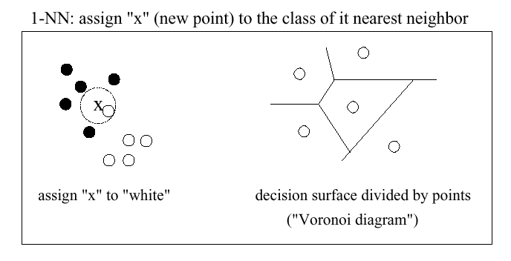
1-Nearest Neighbor (graphically)

Slide 31
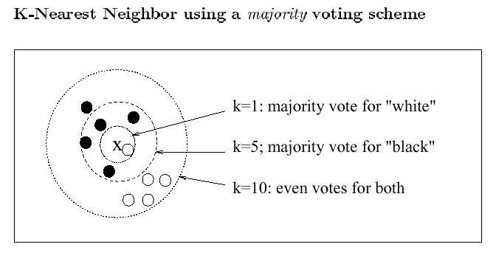
K-Nearest Neighbor using a majority voting scheme

Slide 32
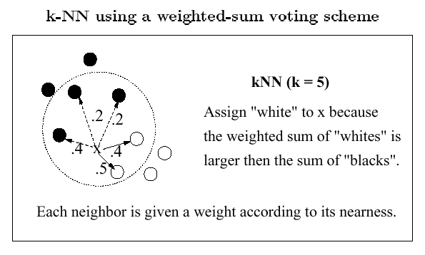
K-NN using a weighted-sum voting Scheme

Slide 33
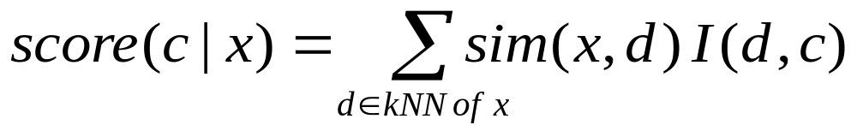
Category Scoring for Weighted-Sum
The score for a category is the sum of the similarity scores between the point to be classified and all of its k-neighbors that belong to the given category.
To restate:
where x is the new point; c is a class (e.g. black or white);
d is a classified point among the k-nearest neighbors of x;
sim(x,d) is the similarity between x and d;
I(d,c) = 1 iff point d belongs to class c;
I(d,c) = 0 otherwise.

Slide 34
The kth Nearest Neighbor Rule
(Fix and Hodges, 1951)
Define a metric to measure “closeness” between any two points.
Fix k (empirically chosen).
Given a new point x and a training set of classified points.
  Find the k nearest neighbors (kNN) to x in the training set.
  Classify x as class y if more of the nearest neighbors are in class y than in any other classes (majority vote).

Slide 35
kNN for Text Categorization
(Yang, SIGIR-1994)
Represent documents as points (vectors).
Define a similarity measure for pairwise documents.
Tune parameter k for optimizing classification effectiveness.
Choose a voting scheme (e.g., weighted sum) for scoring categories
Threshold on the scores for classification decisions.

Slide 36
Thresholding for Classification Decisions
Alternative thresholding strategies:
  Rcut: For each document to be categorized, rank candidate categories by score, and assign YES to the top-m categories (where m is some fixed number).
  Pcut: Applies only when we have a whole batch of documents to be categorized. Make the category assignments proportional to the category distribution in the training set (i.e. if 1/4th of the training documents were in the category “Coffee Maker” then we will assign 1/4th of the documents in this batch to the “Coffee Maker” category).
  Scut: For each category, choose a threshold score (empirically). Any document with a category score that surpasses its respective threshold will be predicted to be a member of that category.
Notes:
Which strategy is best?
-- depends on classifiers (similarity scores, k, etc.), datasets, and performance measures.

Slide 37
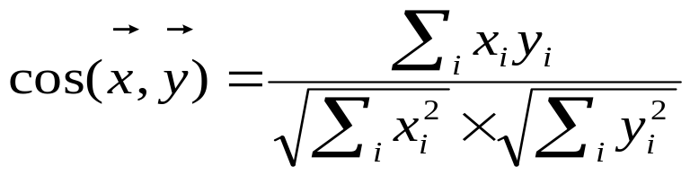
Possible Similarity Measures
Cosine similarity
Euclidean distance
Kernel functions
Kullback-Leibler distance (distance between two probability distributions)

Slide 38
Key Components (revisited)
Functional definition of “similarity”
  e.g. cos, Euclidean, kernel functions, ...
How many neighbors do we consider?
  Value of k determined empirically (see methodology section)
Does each neighbor get the same weight?
  Weighted-sum or not
All categories in neighborhood? Most frequent only? How do we make the final decision?
  Rcut, Pcut, or Scut

Slide 39
Approaches to Automated Text Categorization
Regression based on Least Squares Fit (1991)
Nearest Neighbor Classification (1992)
Bayesian Probabilistic Models (1992)
Symbolic Rule Induction (1994)
Neural Networks (1995)
Rocchio approach (traditional IR, 1996)
Support Vector Machines (1997)
Boosting or Bagging (1997)
Hierarchical Language Modeling (1998)
First-Order-Logic Rule Induction (1999)
Maximum Entropy (1999)
Hidden Markov Models (1999)
Error-Correcting Output Coding (1999)
  ...
Notes:
Note that nearly all of these methods were invented before these dates. These dates indicate their application to text categorization.

Slide 40
Evaluation Methodology and Performance Metrics

Slide 41
How are we doing?
Suppose we have a set D of labeled documents that we use as our training set for 1-NN. We need an idea of how well this system will perform in the future. So, we go through D and make predictions for each document.
  What will our accuracy be?
  Is this a fair assessment of its performance? (i.e. is it likely that the performance will be within a small tolerance of what we’ve estimated).
Notes:
The accuracy will be 100% since each point is in the training set. It is its own nearest neighbor, and thus, we will classify it correctly.

Slide 42
Hold-out Sets
Estimating our performance on data we used in training is likely to give us a very skewed estimate of the final system’s performance. As a result, if we have a set of labeled data, D, we typically split it into a training set,D_{train}, and a hold-out set, D_{test}.
D_{train} is the only data given to the classifier for training. D_{test} can then be used to estimate performance independently. Once performance estimates are used to choose the best classifier, the final classifier is usually trained over all of D before deployment (more data generally means better performance – so our estimate was pessimistic).

Slide 43
Empirically tuning parameters
When parameters need to be empirically tuned as a part of training (e.g. choosing k), the performance of each possible choice needs to be estimated. For the same reasons as above, the classifier cannot simply check the performance on D_{train} to estimate future performance. Therefore D_{train} is usually subdivided into a portion used to train and another portion used for picking optimal parameters (usually referred to as the validation set).
After setting the parameters, the classifier trains over all of D_{train} before returning to the function that will evaluate its performance over D_{test}.

Slide 44
Classification Performance Measures
Given n test documents and m classes in consideration, a classifier makes n × m binary decisions. A two-by-two contingency table can be computed for each class.
 | truly YES | truly NO
system YES | a | b
system NO | c | d

Slide 45
Classification Performance Measures
Recall = a/(a+c) where a + c > 0 (o.w. undefined).
  Did we find all of those that belonged in the class?
Precision = a/(a+b) where a+b>0 (o.w. undefined).
  Of the times we predicted it was “in class”, how often are we correct?
Accuracy = (a + d) / n
  When one classes is overwhelmingly in the majority, this may not paint an accurate picture.
Others: miss, false alarm (fallout), error, F-measure, break-even point, ...

Slide 46
Summary

Slide 47
Pros of kNN
Simple and effective (among top-5 in benchmark evaluations)
  Non-linear classifier (vs linear)
  Local estimation (vs global)
  Non-parametric (very few assumptions about data)
  Reasonable similarity measures (borrowed from IR)
Computation (time & space) linear to the size of training data
Low cost for frequent re-training, i.e., when categories and training documents need to be updated (common in Web environment and e-commerce applications)

Slide 48
Cons of kNN:
Online response is typically slower than eager learning algorithms
  Trade-off between off-line training cost and online search cost
Scores are not normalized (probabilities)
  Comparing directly to and combining with scores of other classifiers is an open problem
Output not good in explaining why a category is relevant
  Compared to DTree, for example (take this with a grain of salt).

Slide 49
Summary
Organizational view of data effective navigation.
TC studies how to automatically classify documents by concepts.
kNN is one of the most effective methods (and arguably the simplest).
Many algorithms have been developed for TC in machine learning.
More operational TC systems in large applications are needed.
Automated TC for Yahoo!, etc., is an open challenge.

Slide 50
Other Resources & Notes
Machine Learning in Automated Text Categorization, F. Sebastiani, ACM Computing Surveys, Vol. 34, No. 1, 2002.
To access, go to www.acm.org and follow the links: Digital Library Journals ACM Computing Surveys
Much of the material of this lecture was borrowed with permission from Yiming Yang’s lectures www.cs.cmu.edu/~yiming . Her page has links to many other useful papers and text categorization resources.

